Slide 1
CSCE 313 – Concurrency and threads
Reading Reference:
Textbook: Chapter 4 (Section 4.1-4.4)
Aakash Tyagi CSCE 313 Spring 2016
February 25, 2016

Slide 2
First, A quick recap on scheduling
FCFS
FCFS is simple and minimizes overhead
If tasks are equal in size, FCFS is optimal in terms of average response time.
If tasks are variable in size, then FCFS can have very poor average response time (e.g. a large task ahead of tiny tasks)

Slide 3
Quick Recap on Scheduling (contd.)
SJF is optimal in terms of average response time
If tasks are equal in size, Round Robin will have very poor average response time with short time slices
Tasks that intermix processor and I/O benefit from SJF and can do poorly under Round Robin
Round Robin avoids starvation

Slide 4
Quick Recap on Scheduling (contd.)
By manipulating the assignment of tasks to priority queues, an multi-level-feedback queue scheduler can achieve a balance between responsiveness, low overhead, and fairness

Slide 5
Moving on to Talk Threads! (some recap on related concepts)
Process versus Program
Concurrency versus Parallelism
Process context switching and Process Control Block
Process Tree

Slide 6
Process =? Program
main () {
…;
}
A() {
…
}
main () {
…;
}
A() {
…
}
Heap
Stack
A
main
Program
Process
More to a process than just a program:
Program is just part of the process state
e.g. I run emacs on lectures.txt, you run it on homework.txt – same program, different processes
Less to a process than a program:
A program can invoke more than one process
gcc starts up sub-component processes

Slide 7
Today’s Conversation
Threads
A bit complex topic but central to our understanding of modern computer systems (HW and SW)
We will build concepts incrementally and tie the picture together at the end
We will continue the crux of discussion on threading after the midterm
Next Tuesday is Midterm Review
Adapted from contemporary courses in OS/Systems taught at Berkeley, UW, TAMU,
UIUC, and Rice. Special acknowledgment to Profs Gu/Bettati at TAMU, Culler and
Joseph at Berkeley

Slide 8
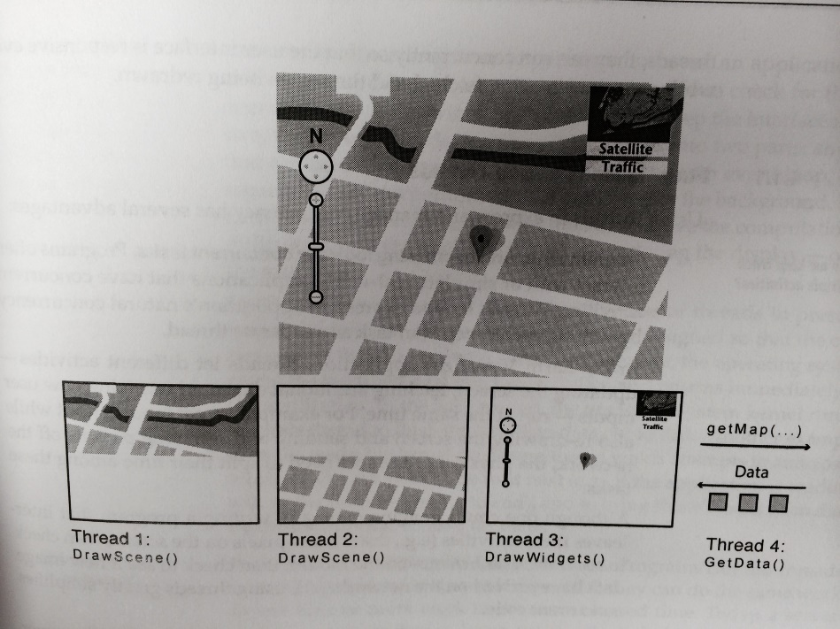
Let’s picture this scenario
Processes
thread
thread
thread
thread
Multiple programs (processes) doing their individual functions
PAYING THE COST OF CONTEXT SWITCHING
WHAT IF WE COULD REDUCE THE COST
AT THE EXPENSE OF SOMETHING
SO THE NET PERFORMANCE IS STILL BETTER
Credit – NASA Earth Observatory
Two ‘threads’ each draw parts of the scene, a third ‘thread’ manages the user interface widgets, and a fourth ‘thread’ fetches new data from the remote server
In a ‘traditional program’ these will be sequenced
Key differentiation is “facilitated concurrency”.
A traditional program is a single ‘thread’
Inside a program, we can represent each concurrent task as “Thread”

Slide 9
Why Processes & Threads?
Goals:
Multiprogramming: Run multiple applications concurrently
Protection: Don’t want a bad application to crash system!
Solution:
Virtual Machine abstraction: give process illusion it owns machine (i.e., CPU, Memory, and IO device multiplexing)
Process: unit of execution and allocation
Challenge:
Process creation & switching expensive
Need concurrency within same app (e.g., web server)
Solution:
Thread: Decouple allocation and execution
Run multiple threads within same process
Notes:
Multiprogramming: Older idea than multi-tasking, run jobs concurrently (load several into memory), but not necessarily “interactively”.

Slide 10
Motivation for SW Threads
Operating systems need to be able to handle multiple things at once (MTAO)
processes, interrupts, background system maintenance
Servers need to handle MTAO
Multiple connections handled simultaneously
Parallel programs need to handle MTAO
To achieve better performance
Programs with user interfaces often need to handle MTAO
To achieve user responsiveness while doing computation
Network and disk bound programs need to handle MTAO
To hide network/disk latency

Slide 11
Motivation for HW Threads
MTAO for performance
Assists for SW threads

Slide 12
Motto for Threading
Multiple Things at Once
MTAO

Slide 13
Programs, Process, Threads, MultiCore, Multithreads…
Scenario: Warehouse Accountant needs to
look at the invoice list
verify it against the purchase order list and
then issue a check for valid purchases.
There are multiple sheets of purchase orders and invoices.
More than one accountant are qualified and allowed to work on this assignment. Constraint is that an accountant can only work on his assigned list.
An accountant must have a TAG before he can work on his list.
There is only one tag to go around.

Slide 14
Scenario Build
Scenario1: No accountant: Analogous to a “Program”

Slide 15
Scenario Build
Scenario2: Accountant present in Room1 with a TAG, along with all lists and a checkbook: Akin to a Process in execution

Slide 16
Scenario Build
Scenario3: Accountant2 shows up in Room2. At some point Accountant1 goes on lunch break
His stopping point and local records are saved (aka PCB).
Tag and Global lists (invoice and PO) are walked over to Room2 so Accountant 2 can take over.
When Accountant 2 takes a break, the tag and lists are walked over to Room1 again…..Akin to 2 processes and context switch from Process1 to Process2.

Slide 17
Scenario Build
Scenario4: Now picture Accountants 1 and 2 are sitting in the same room with global lists visible to both.
Whoever gets the TAG recalls his previous stopping point and resumes.
There’s no walking across the rooms, carrying lists etc.
They just have to be careful not to clobber over each other’s lists. This is akin to Threads.

Slide 18
Putting it together: Process
(Unix) Process
A(int tmp) {
if (tmp<2)
B();
printf(tmp);
}
B() {
C();
}
C() {
A(2);
}
A(1);
…
Process
Memory
threads
Mem.
I/O State
(e.g., file, socket contexts)
…
IO
state
CPU
state
CPU
state
CPU state (PC, SP, registers..)

Slide 19
Putting it together: Processes
Process 1
Process 2
Process N
Process Switch overhead: high
CPU state: low
Memory/IO state: high
Process creation: high
Protection
CPU: yes
Memory/IO: yes
Sharing overhead: high (involves at least a context switch)
Mem.
Mem.
Mem.
IO
state
IO
state
…
IO
state
CPU
state
CPU
state
CPU
state
CPU sched.
OS
1 process at a time
CPU
(1 core)

Slide 20
Putting it together: Threads
Process 1
Process N
threads
threads
Thread Switch overhead: low (only CPU state)
Thread creation: low
Protection
CPU: yes
Memory/IO: No
Sharing overhead: low
Mem.
Mem.
…
IO
state
…
…
IO
state
CPU
state
CPU
state
CPU
state
CPU
state
CPU sched.
OS
1 thread at a time
CPU
(1 core)

Slide 21
Putting it together: Multi-Cores
Process 1
Process N
threads
threads
Switch overhead: low (only CPU state)
Thread creation: low
Protection
CPU: yes
Memory/IO: No
Sharing overhead: low (thread switch overhead low)
Mem.
Mem.
…
IO
state
…
…
IO
state
CPU
state
CPU
state
CPU
state
CPU
state
CPU sched.
OS
4 threads at a time
core 1
Core 2
Core 3
Core 4
CPU

Slide 22
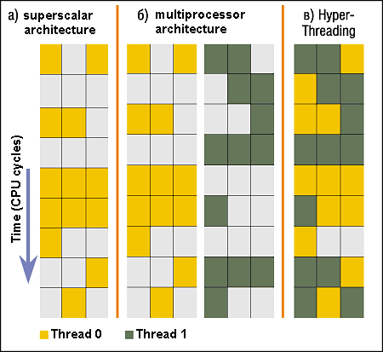
Hardware Parallelism (only for reference)
Triple issue SS arch
Hardware technique
Superscalar processors can execute multiple instructions that are independent.
Hyper-threading duplicates register state to make a second “thread,” allowing more instructions to run.
Can schedule each thread as if were separate CPU
But, sub-linear speedup!
Original technique called “Simultaneous Multithreading”
See http://www.cs.washington.edu/research/smt/index.html
SPARC, Pentium 4/Xeon (“Hyperthreading”), Power 5
P0
P1
Colored blocks show instructions executed

Slide 23
Putting it together: Hyper-Threading
Process 1
Process N
threads
threads
Switch overhead between hardware-threads: very-low (done in hardware)
Contention for ALUs/FPUs may hurt performance
Mem.
Mem.
…
IO
state
…
…
IO
state
CPU
state
CPU
state
CPU
state
CPU
state
CPU sched.
OS
hardware-threads
(hyperthreading)
8 threads at a time
core 1
core 2
core 3
core 4
CPU

Slide 24
Thread Abstraction
Infinite number of processors
Threads execute with variable speed
Programs must be designed to work with any schedule
Notes:
Execution model: each thread runs on a dedicated virtual processor with unpredictable and variable speed.

Slide 25
Programmer vs. Processor View

Slide 26
Possible Executions

Slide 27
ATM Bank Server
ATM server problem:
Service a set of requests
Do so without corrupting database
Don’t hand out too much money

Slide 28
ATM bank server example
Suppose we wanted to implement a server process to handle requests from an ATM network:
BankServer() { while (TRUE) { ReceiveRequest(&op, &acctId, &amount); ProcessRequest(op, acctId, amount); } }
ProcessRequest(op, acctId, amount) { if (op == deposit) Deposit(acctId, amount); else if … }
Deposit(acctId, amount) { acct = GetAccount(acctId); /* may use disk I/O */ acct->balance += amount; StoreAccount(acct); /* Involves disk I/O */ }
How could we speed this up?
More than one request being processed at once
Multiple threads (multi-proc, or overlap comp and I/O)

Slide 29
Can Threads Help?
One thread per request!
Requests proceeds to completion, blocking as required:
Deposit(acctId, amount) { acct = GetAccount(actId); /* May use disk I/O */ acct->balance += amount; StoreAccount(acct); /* Involves disk I/O */ }

Slide 30
Can Threads Help?
Unfortunately, shared state can get corrupted: Thread 1 Thread 2 load r1, acct->balance load r1, acct->balance add r1, amount2 store r1,acct->balance add r1, amount1 store r1, acct->balance

Slide 31
Problem is at the lowest level
Most of the time, threads are working on separate data, so scheduling doesn’t matter:
Thread A Thread B
x = 1; y = 2;
However, What about (Initially, y = 12):
Thread A Thread B
x = 1; y = 2;
x = y+1; y = y*2;
What are the possible values of x?
Thread A Thread B
x = 1;
x = y+1;
y = 2;
y = y*2
x=13
Notes:
X could be (13, 5, 3)

Slide 32
Problem is at the lowest level
Most of the time, threads are working on separate data, so scheduling doesn’t matter:
Thread A Thread B
x = 1; y = 2;
However, What about (Initially, y = 12):
Thread A Thread B
x = 1; y = 2;
x = y+1; y = y*2;
What are the possible values of x?
Thread A Thread B
y = 2;
y = y*2;
x = 1;
x = y+1;
x=5
Notes:
X could be (13, 5, 3)

Slide 33
Problem is at the lowest level
Most of the time, threads are working on separate data, so scheduling doesn’t matter:
Thread A Thread B
x = 1; y = 2;
However, What about (Initially, y = 12):
Thread A Thread B
x = 1; y = 2;
x = y+1; y = y*2;
What are the possible values of x?
Thread A Thread B
y = 2;
x = 1;
x = y+1;
y= y*2;
x=3
Notes:
X could be (13, 5, 3)

Slide 34
Summary
Threading is great for performance
Threading is tricky and carry hazards!

